Slide 1

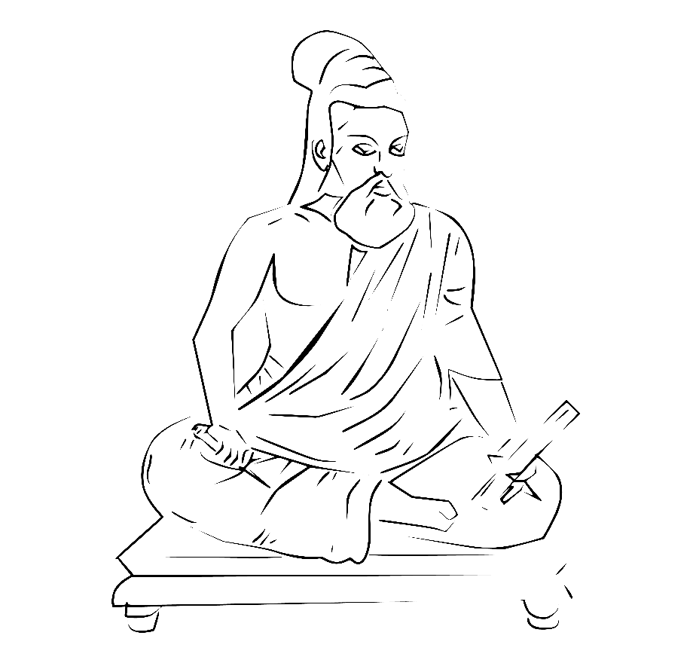
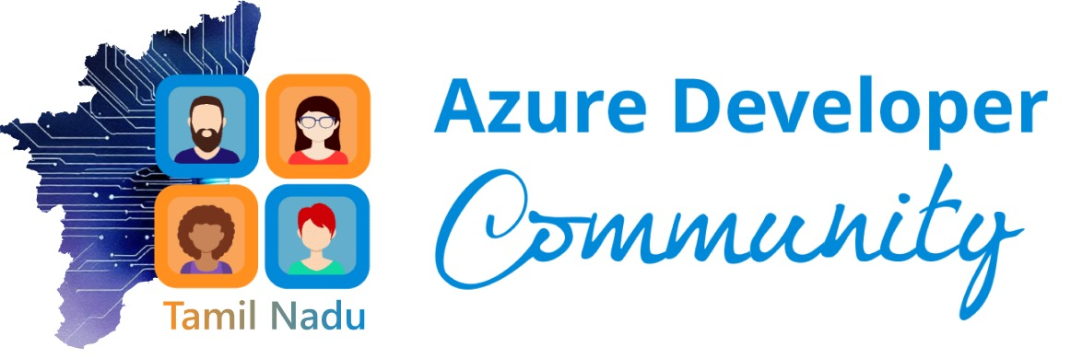


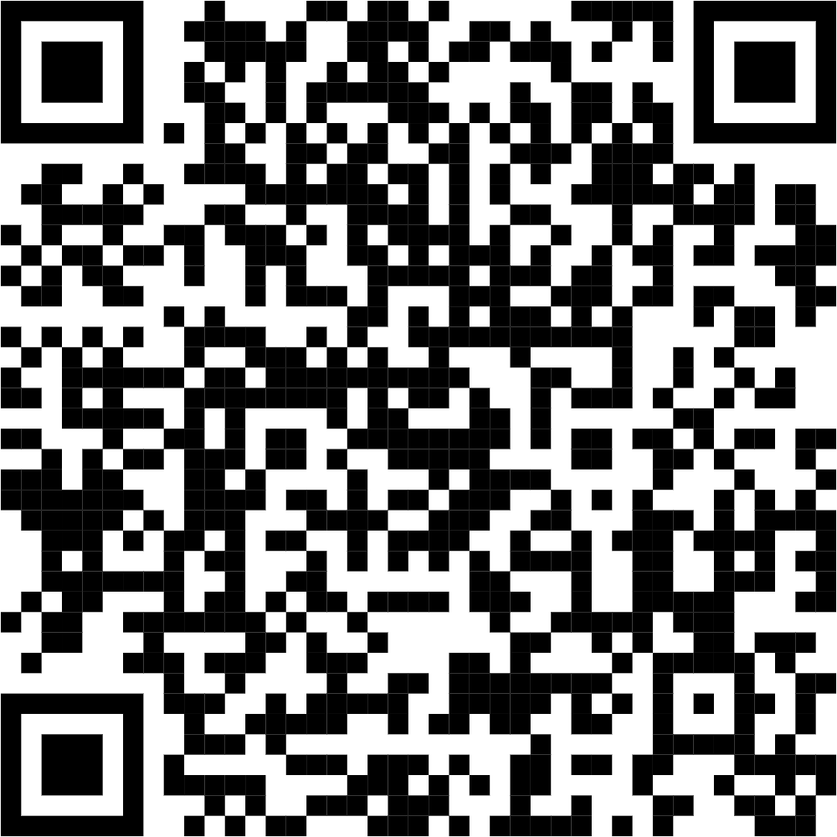




Slide 2
What we do?
Meetups
Network of Beginners, Professionals & Experts
Azure Cert Study Jam
CSR Activities

Slide 3

Introduction
Experience in Analytics, AI OPs and data engineering
Microsoft AI MVP, Azure Dev Lead and Microsoft Certified - Azure and AI Engineer
Enthusiastic learner and tech community contributor
Navaneethan Gopal
Data science Manager @ Ingram Micro
LinkedIn – https://www.linkedin.com/in/navaneethan-gopal-9b101612/
Twitter - https://twitter.com/NavaneethhGopal

Slide 4
Current Situation
AI can write production-ready code
AI can generate test cases from Jira stories
AI can debug your stack trace
AI can build entire workflows
This is system design with intelligence inside it.
Tools like Claude are introducing workflow-based agents.
Open-source communities are building “Open Claw” style stacks.
Retrieval pipelines are evolving beyond just vector search.
Agents are being given memory, feedback loops, autonomy.

Slide 5
Agenda - today’s agenda reflects exactly that evolution.
We’re not talking about surface-level AI.
Engineering Autonomy
Self-healing dev workflows.
Moving from “store embeddings” to “design information flow.”
RLHF
Feedback loops that make AI agents smarter over time.
Owning Your AI
Building an Agent Engine from Scratch
No magic. No wrappers.
Imagine CI/CD pipelines that detect, reason, and fix failures automatically.
Retrieval Thinking (Not Just RAG)
That’s not model usage. That’s model governance.
Running open-source models.
Cost control. Data privacy. Strategic advantage.
Understanding what’s under the hood.

Slide 6
Every major technological shift created panic.
Let me share a quick example.
Designs retrieval pipelines
Optimizes inference cost
Adds observability to agents
Implements guardrails
Fine-tunes workflows with feedback
Same person.
Different mindset.
That mindset shift is what today is about.
A traditional backend engineer writes APIs.
A modern AI-native engineer:
When cloud computing came: “Data centers will disappear. Infra teams are finished.”
What happened instead?
Cloud architects became the highest paid professionals.
When DevOps came: “Ops is dead.”
Instead?
Platform engineers became indispensable.
Now it’s AI.
And here’s the truth from a data leadership lens: The demand is not reducing.
The skill expectations are increasing.
Notes:
And I want to say this clearly:
The fact that you are sitting here means you’re already ahead.
While many are scrolling LinkedIn debating whether AI is hype…
You chose to show up and build.
That matters.

Slide 7
Next Steps
How can I use this tomorrow?
How can I position myself as the AI enabler in my organization?
How can I integrate this into my team’s workflow?
They need people who understand
Architecture, Governance, Cost, Risk, Observability, Feedback loops That’s leadership territory. We are not here to consume AI. We are here to engineer it.

Slide 8
Session notes For the best experience
let’s make today practical.
Let’s make it technical.
Let’s make it uncomfortable in the best possible way.
Ask questions.
Challenge speakers.
Network aggressively.
Because the next 6-12 months in AI will redefine careers.
And the people in this room? You’re positioning yourselves to be the ones driving that change.
Engage during the talk, feel free to ask questions between solutions but stick to the topic Less of a talk more of a conversation Pls don’t leave your learnings in this room and share with others
Ask your doubts Don’t hesitate to clear your doubts
Slides & demo code will be made available right after session
After the session is complete, feel free to ask off-topic questions too
Wish and Greet your teammate and network

Slide 9
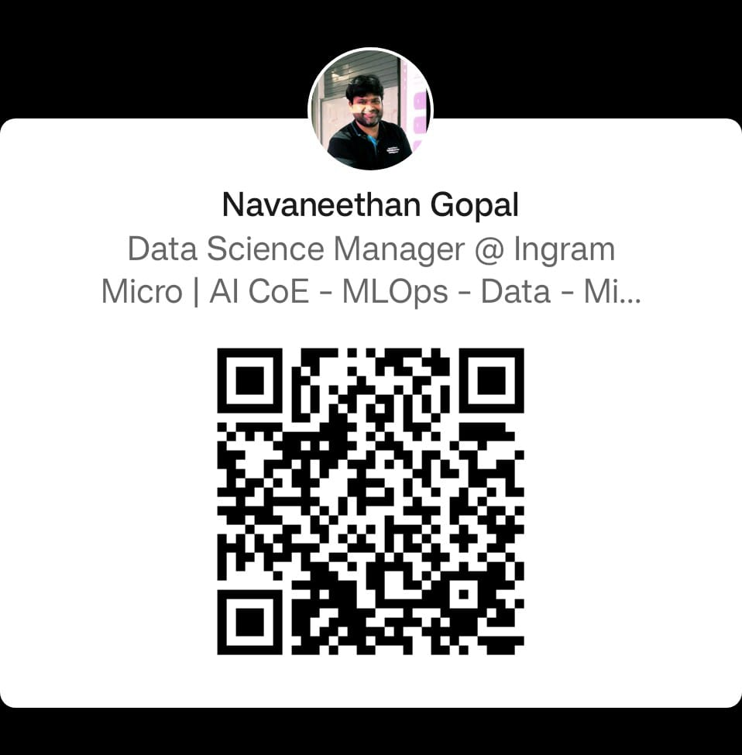
Open for Q&A
Presentation title
Thank you!!

Slide 10
Learning Resources
https://learn.microsoft.com/en-us/training/modules/intro-to-azure-virtual-machines/?wt.mc_id=MVP_366034
https://developer.microsoft.com/en-us/offers/30-days-to-learn-it/?wt.mc_id=MVP_366034
https://azure.microsoft.com/en-in/get-started/on-demand/?wt.mc_id=MVP_366034
https://ignite.microsoft.com/en-US/home/?wt.mc_id=MVP_366034
https://learn.microsoft.com/en-us/credentials/browse/?levels=intermediate&subjects=artificial-intelligence&wt.mc_id=MVP_366034
https://learn.microsoft.com/en-us/credentials/certifications/azure-fundamentals/?practice-assessment-type=certification&wt.mc_id=MVP_366034
https://learn.microsoft.com/en-us/credentials/certifications/azure-ai-fundamentals/?practice-assessment-type=certification&wt.mc_id=MVP_366034
https://learn.microsoft.com/en-us/credentials/certifications/azure-data-fundamentals/?practice-assessment-type=certification&wt.mc_id=MVP_366034

Slide 11
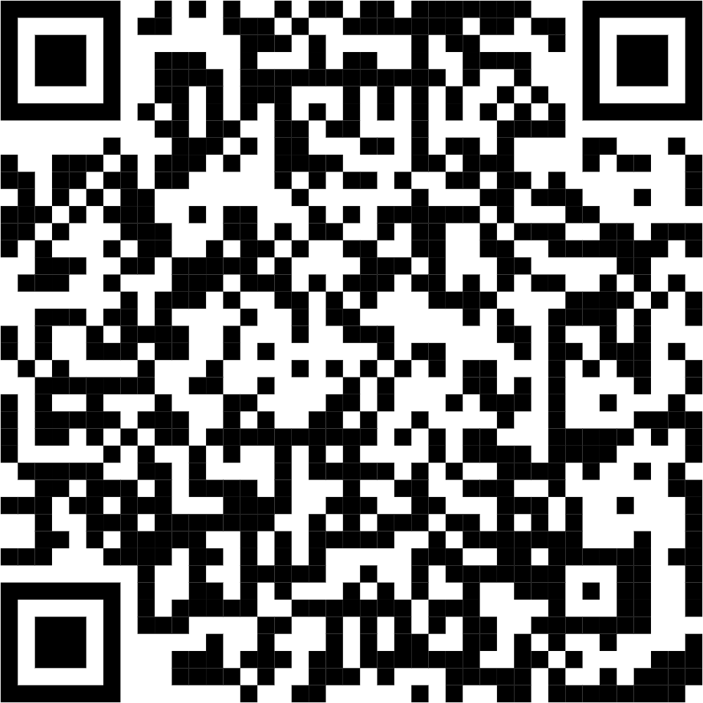
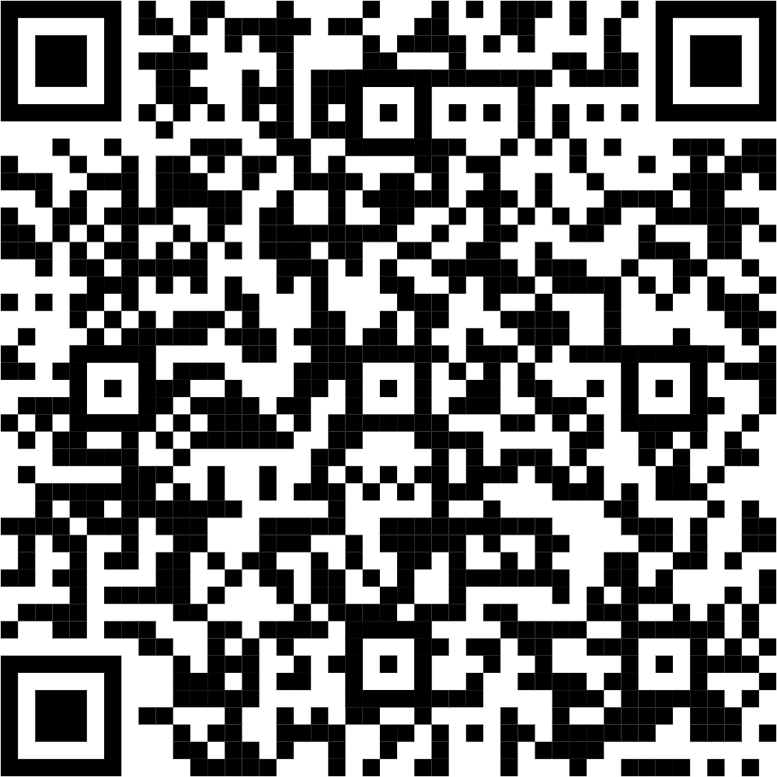
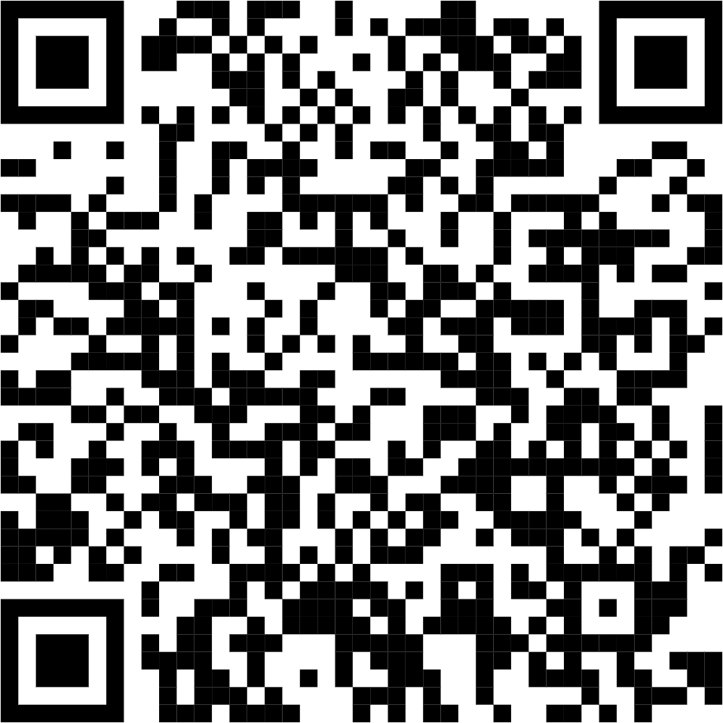
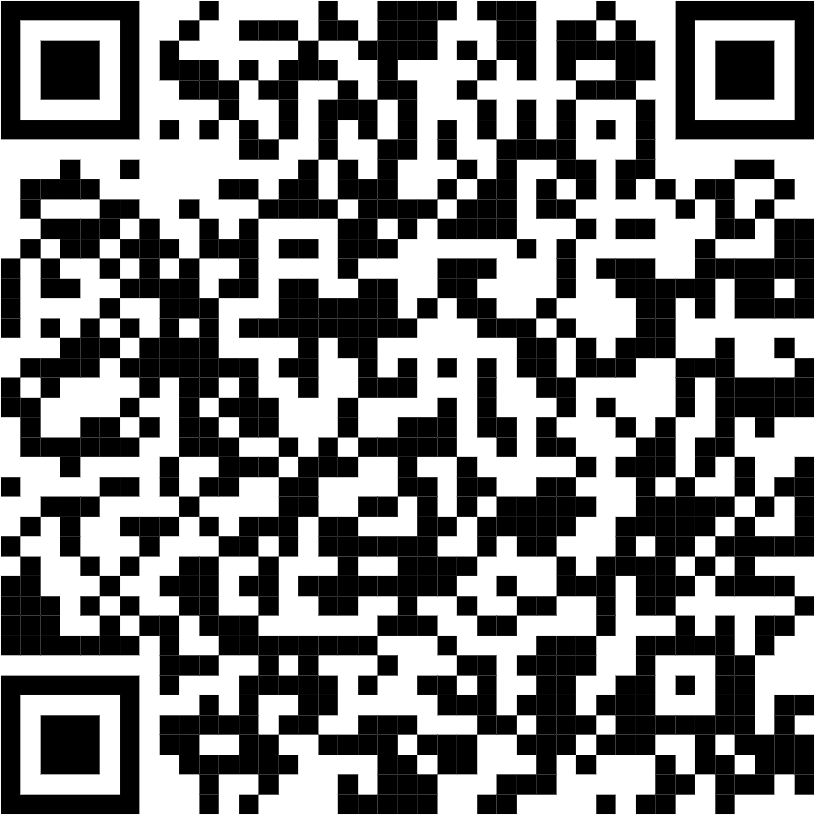
Learn the Basics of AI
Start using AI tools and apply it
Find the use cases
Effective ways to utilize CSPs.
Notes:
https://www.microsoft.com/en-us/customers/search/?filters=business-need%3Aartificial-intelligence&sortBy=PublishedDate+Desc
https://learn.microsoft.com/en-us/ai/?tabs=developer
https://www.kaggle.com/learn-guide/5-day-genai
https://aiskillsfest.event.microsoft.com/?wt.mc_id=aiskillsfest_eventpage_webpage_wwl_mslearn

